Slide 1
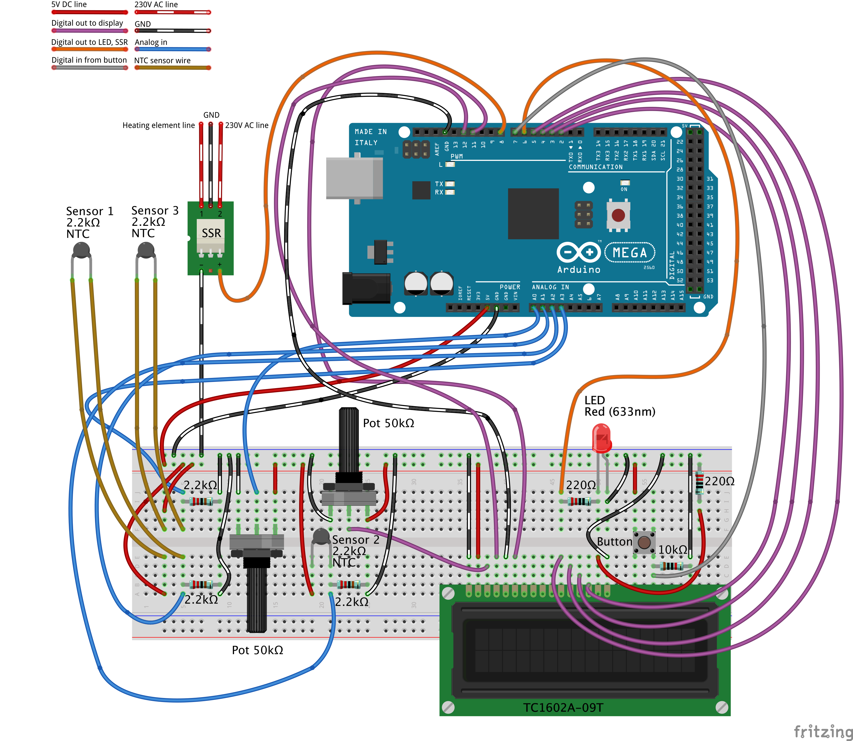
Control of Sous Vide Cooking Device
Design project in systems, control and mechatronics
Control of both the pump and the heating element
Model
System Identification – tests based on our model Model based testing?
Both my formulas + pic Tonies Simulink
A+B statespace
Model of the Sous Vide cooking device.
System Identification

Slide 2
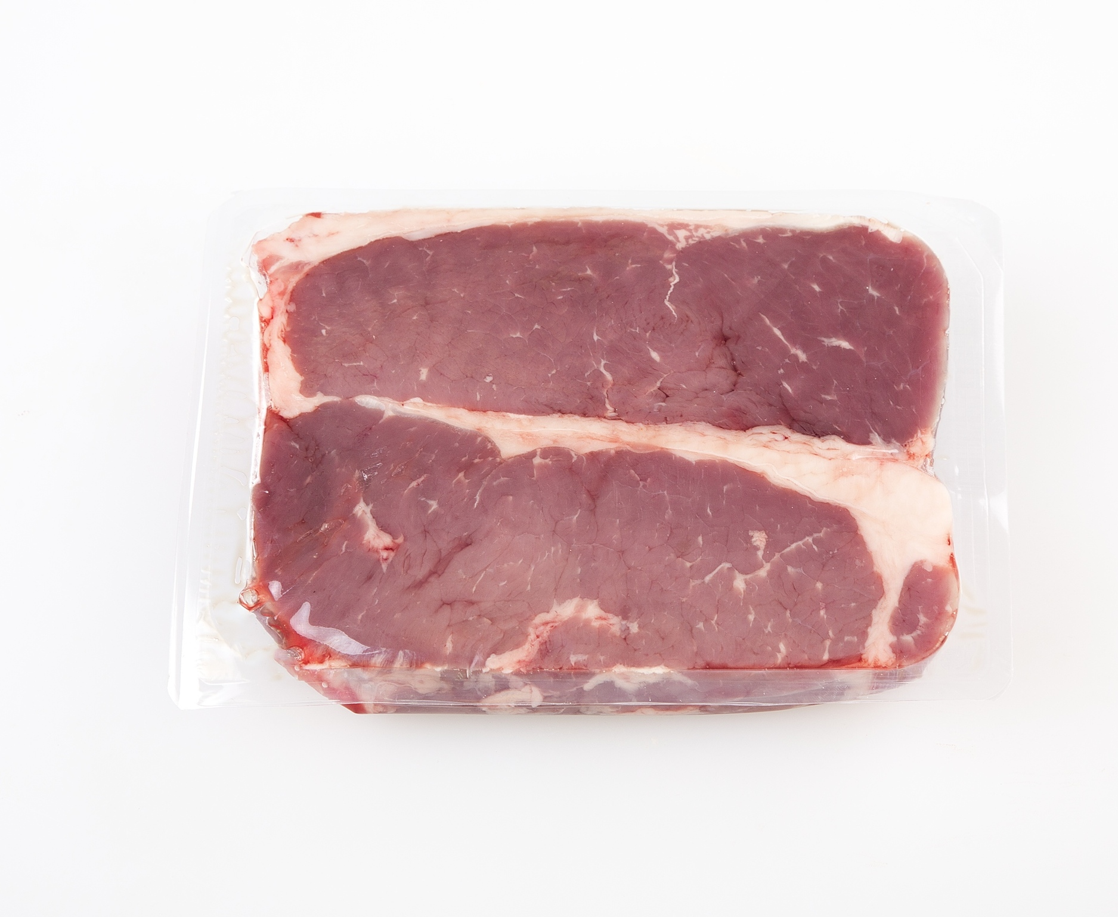
Q element
Q jacket
Q accumlation
Q pump
Q food

